Slide 1


Slide 2

Naive Bayes

Slide 3
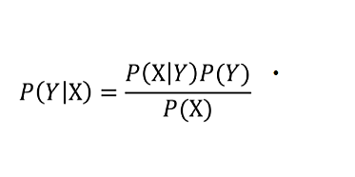
Bayes’ Theorem

Slide 4
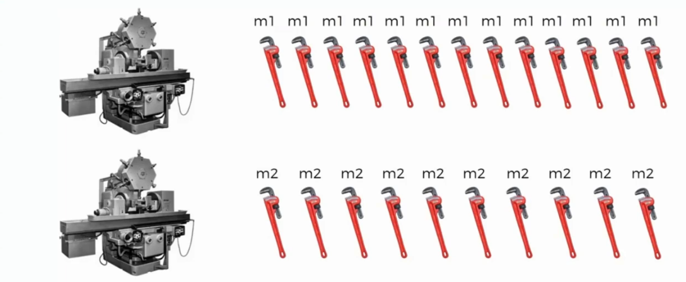
Example

Slide 5


Slide 6

What is the probability ? P(Defect|Mach2)=?
Mach1 : 30 Wrenches/hr
Mach2 : 20 Wrenches/hr
Out of all produced parts :We can see that 1%are defective
Out of all defective parts:
we can see that 50% came from mach1 And 50% came from mach2

Slide 7

What is the probability ? P(Defect|Mach2)=?
P(Mach1)=30/50
P(Mach2)=20/50
P(Defect)=1%
P(Mach1|Defect)=50%
P(Mach2|Defect)=50%
P(Defect|Mach2) $=\frac{\text{P}\text{(}\text{Mach}\text{2}\text{|}\text{Defect}\text{) }\text{∗}\text{P}\text{(}\text{Defect}\text{)}}{\text{P}\text{(}\text{Mach}\text{2}\text{)}}$ =1.25%

Slide 8

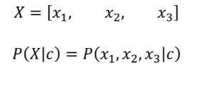
Naive Bayes
For multiple features:

Slide 9
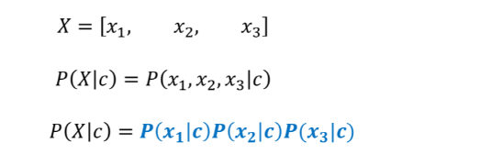
Naive Bayes
Our classifier is Naïve, it assumes all features are independent

Slide 10
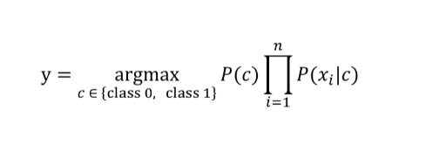
Naive Bayes
In general, for n features:

Slide 11
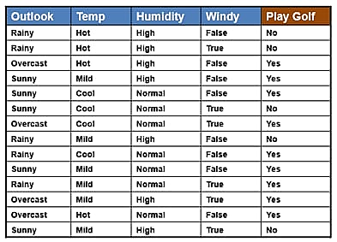
Example

Slide 12
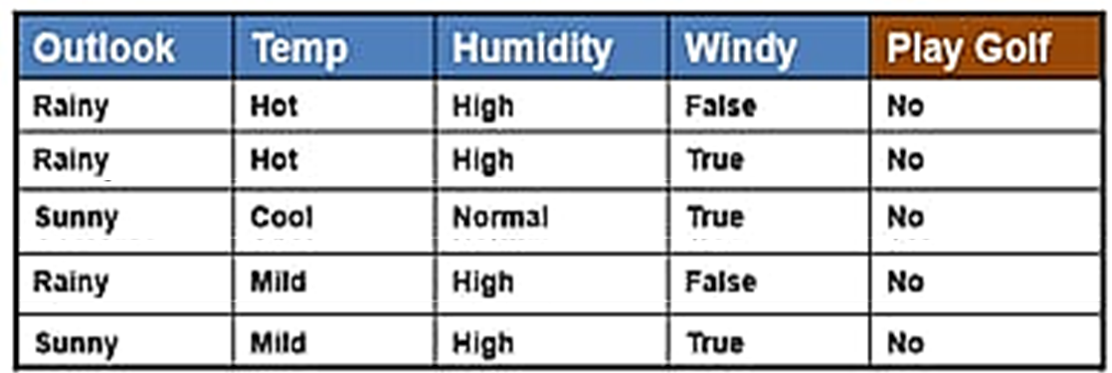
NO

Slide 13
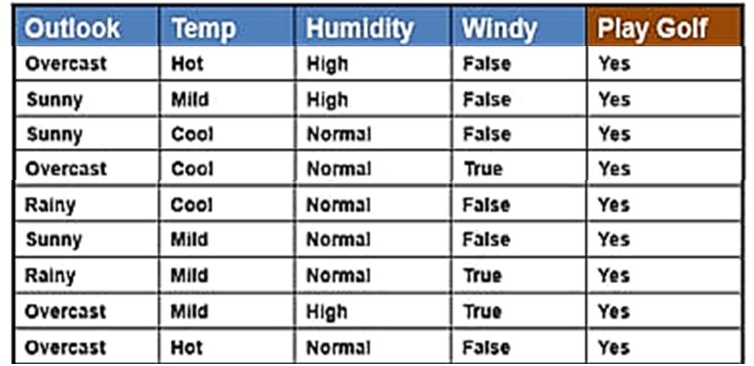
Yes

Slide 14
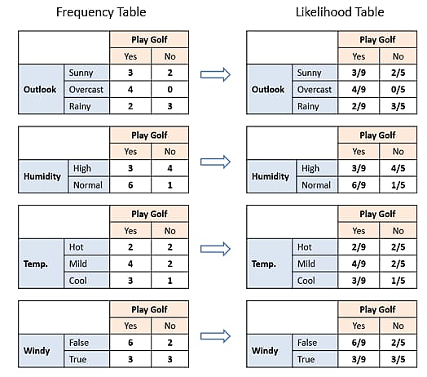
We can see that
P(Yes)=9/14
P(No)=5/14

Slide 15
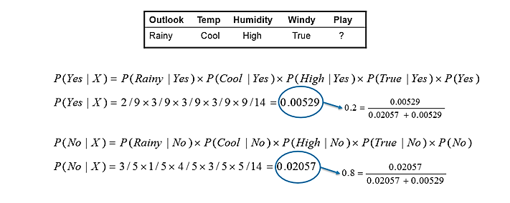
SO it predict -->(Play Golf=No) In this example we have 4 inputs (predictors).

Slide 16


